Slide 1

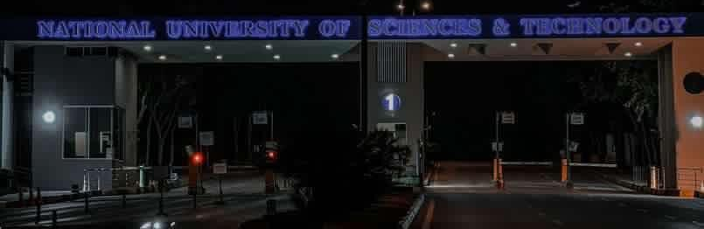
Problem Statement: NUST Entry Delays
The Impact:
Average wait times exceeding 2 minutes.
Long queues causing congestion.
Significant loss of time for students and faculty.
Inefficient use of security personnel.
.
The Challenge: Daily bottlenecks at NUST main gates due to manual security checks.

Slide 2


Our Solution: Automated Entry System
The Core Concept
Key Objectives
An intelligent application integrating barcode scanning with real-time facial recognition technology to automate the identity verification process at campus entry points.
To eliminate manual checking errors, significantly reduce queue wait times, and strictly enforce NUST's student ID carriage policy through a seamless, automated workflow.

Slide 3
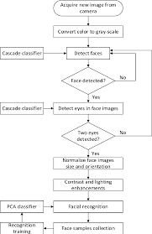
System Architecture
The system follows a linear, secure validation pipeline:
1.
Input: Student presents ID Card.
2.
Scan: System reads the unique Barcode.
3.
Query: Validates Barcode against Student DB.
4.
Verify: Triggers Camera for Facial Recognition.
5.
Action: Matches Face with ID photo. Gate Opens.

Slide 4









Technologies Used
Facial Recognition
OpenCV
Pyzbar
Use already existing models to recognize faces at very high speeds flawlessly
Advanced image processing library used for real-time facial recognition.
Specialized Python library for accurate and fast barcode decoding.

Slide 5







Step-by-Step Workflow
Step 1
Step 2
Step 3
Step 4
Barcode Scanning via Camera
Database Validation
Facial Recognition Match
Access Granted / Denied

Slide 6
Key Features
Efficient Queue Management: Drastically reduces wait times during peak hours (morning/afternoon).
Two-Factor Verification: Combines physical card possession (Barcode) with biological verification (Face).
Full Automation: Removes human error and fatigue from the security checking process.
Policy Compliance: Enforces the mandatory carriage of student ID cards for entry.

Slide 7




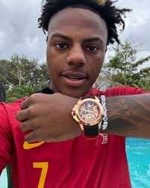
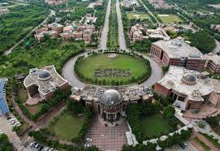
System Benefits
Speed
Security
Experience
Faster entry throughput for students.
Prevents unauthorized access & impersonation.
Smooth, hassle-free campus entry.

Slide 8

Live System Demo
Watch as we demonstrate the seamless integration of barcode scanning and facial recognition in real-time.

Slide 9


Challenges in Development
Technical Hurdles
System Performance
Optimizing OpenCV for varying lighting conditions to ensure high accuracy in facial recognition. Handling real-time video processing without lag.
Ensuring the database queries for student IDs and image retrieval happen instantly to maintain the "fast entry" promise under high load.

Slide 10

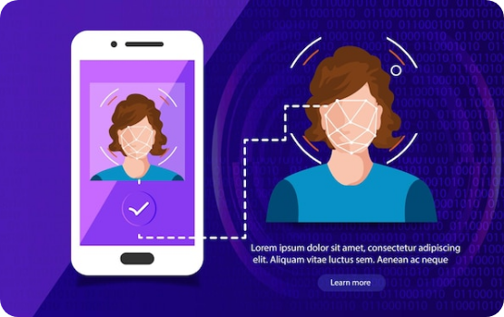
Future Enhancements
Liveness Detection: Advanced algorithms to prevent spoofing using photos/videos of students.
Campus Integration: Linking the entry system with library access and automated attendance tracking.
Mobile App: Allowing digital ID entry via a secure student mobile application.

Slide 11
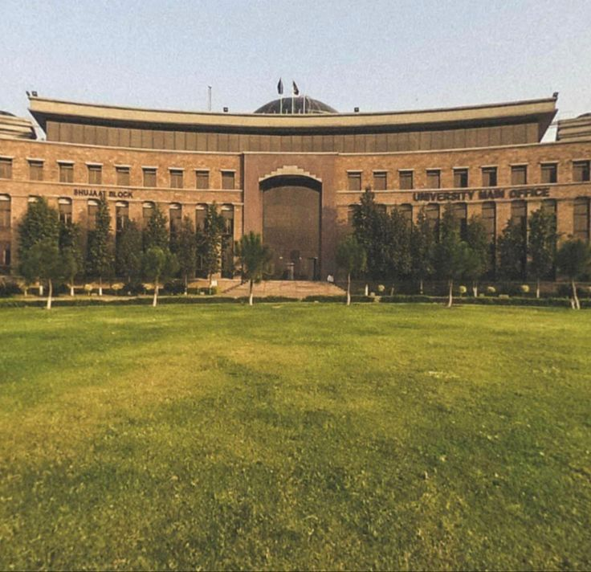
Conclusion
Our Automated Student Entry System effectively solves the critical problem of entry delays at NUST.
By leveraging Python and Computer Vision, we have created a solution that is secure, efficient, and scalable.
Ready for implementation to modernize campus security.

Slide 12
Questions?
Thank you for your attention.

